Slide 1
MOBILE SECURITY OVERVIEW
Defense Against The Dark Arts
March 3 – March 12, 2015
Fernando Ruiz
McAfee
Notes:
Welcome message:
- Privilege to do this, privilege to be here presenting.
- Hope the course has been enjoyable and wish you good luck in your studies.
Welcome to Mobile Security portion of the course.

Slide 2

About Me
Mobile Malware Researcher @McAfee – Intel Security
Have been reversing mobile malware for last 3 years
From Santiago, Chile
Computer Science graduate, “Universidad del BíoBío”, Chile
Previously worked as Software Developer
Notes:
Evolution of:
- mobile networks
- platforms and security
- mobile malware
Android platform
Android malware including exploits.
Deeper Analysis

Slide 3
General agenda Week 8
Mobile Networks Evolution
Mobile OS Overview: Platforms and Security
Mobile Malware Genesis
Calm Before the Storm
Android Malware Revolution
Android Fundamentals
Lesson 1 (90 min)
Lab 1
Static Analysis of Android Malware
Lab 2
Dynamic Analysis of Android Malware
(45 min each one)
Android Malware and Public Exploits.
Native Payload Analysis.
Android Banking Trojans.
Android Malware Heuristics.
Lesson 2 (90 min)
Lab 1
Static Analysis of DroidDream
Lab 2
Dynamic Analysis of an Banking Trojan
(45 min each one)

Slide 4
General agenda Week 9
Dynamic and remote code execution (DexClassLoader, Reflection, addJavascriptInterface)
Android Obfuscation (ProGuard, DexGuard)
Server-side polymorphic malware
Android Bootkits
Lesson 3 (90 mins)
Lab 1
Analysis of Obad
Lab 2
Evade emulator detection
(45 min each one)
Android “Master Key” vulnerability
Android FakeID Vulnerability
Android Ransomware
Lesson 4 (90 mins)
Lab 1
Analysis of ScarePackage
Lab 2
Analysis of SimpleLocker and Decryption
(45 min each one)

Slide 5
Mobile security overview Agenda
Mobile Networks Evolution
Mobile OS Overview: Platforms and Security
Execution Environments
Security Features
System Security Bypass
Mobile Malware Genesis
Calm Before the Storm
Android Malware Revolution
Android Fundamentals
Practical Experience
Notes:
Mobile Networks Evolution
Mobile OS Overview: Platforms and Security
Execution Environments
Security Features
System Security Bypass
Mobile Malware Genesis
Calm Before the Storm
Android Malware Revolution
Android Fundamentals
Practical Experience

Slide 6
Class objectives
By the end of this class you will be to:
Understand mobile networks evolution and related security issues.
Comprehend the current state of mobile platforms and operating systems.
Recognize core differences between current mobile platforms.
Comprehend Android’s different security features.
Understand the difference between Jailbreaking and Rooting.
Learn about the evolution of malware for mobile devices and their novel contributions.
Understand the Android platform and its fundamentals.
Perform basic static and dynamic analysis of Android applications.
Notes:
- Mobile networks and security
- different mobile platforms and OSes.
- Android security features.
- JB vs rooting
- Malware evolution and novel contributions.
- Android platform
- Android applications

Slide 7
Mobile networks evolution
An overview of mobile networks and security features

Slide 8
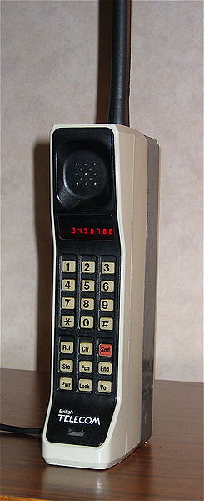
the early days of mobile devices
First call using a handheld mobile phone made by Motorola on 3 April 1973.
First cell phone in the market: Motorola DynaTAC 8000X in 1984 ($3,995):
30 minutes talk time / 8 hours stand-by.
Stores up to 30 phone numbers.
“Special Keys”: Pwr, Snd, Clr, Rcl, Sto, Fcn, Vol, Lock and End
Used the analog cell phone network (1G) AMPS in the U.S.A.
Author: Redrum0486 Source: Wikimedia Commons
Notes:
AMPS: “Advanced” Mobile Phone System
1G (First generation of wireless telephone technology).

Slide 9
Mobile Networks evolution
1G (Analog) 80’s
AMPS
FDMA
Analog
Jamming
Cell Phone cloning
2G (Digital) 90’s
Europe vs U.S.A
GSM = TDMA
Digital AMPS = CDMA
Voice encrypted
GSM = A5 V1/2 (weak)
AMPS = CAVE
2.5G (Data) 2000
Standards
GPRS
CDMA2000-1X
EDGE
Data
3G (Internet) 2001
Packet switching
Standards
WCDMA (Europe/Japan)
CDMA2000 (U.S.A)
TD-SCDMA (China)
Security
A5/3
4G (VoIP) 2010
LTE (GSM)
SMS
WAP
MMS
E-mail
SIM Card
WiMAX (IEEE 802.16)
Notes:
Acronym overload!
AMPS - Advanced Mobile Phone System
FDMA - Frequency Division Multiple Access (10,000 calls = 10,000 channels)
Analog = non-encrypted
SMS = Short Message Service
TDMA = Time Division Multiple Access
CDMA= Code Division Multiple Access
CAVE = Cellular Authentication, Voice Privacy and Encryption
GPRS = General Packet Radio Service
EDGE = Enhanced Data rates for GSM Evolution
WAP = Wireless Application Protocol
MMS = Multimedia Messaging Service
TD-SCDMA = Time Division Synchronous CDMA
LTE = Long Term Evolution

Slide 10
Mobile OS Overview
An overview of current mobile operative systems

Slide 11
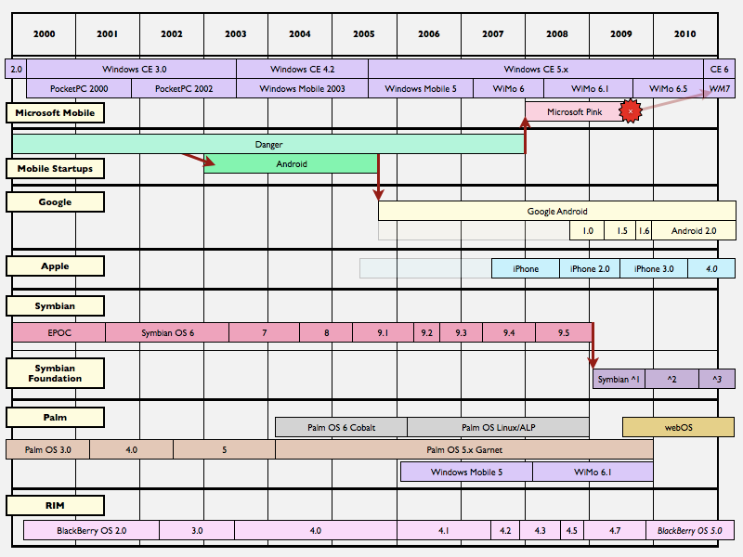
Mobile os history
Source: AppleInsider
Notes:
2000-2010
OS vendor and versions.
Time-line of releases and aquistions
http://en.wikipedia.org/wiki/Comparison_of_mobile_operating_systems

Slide 12
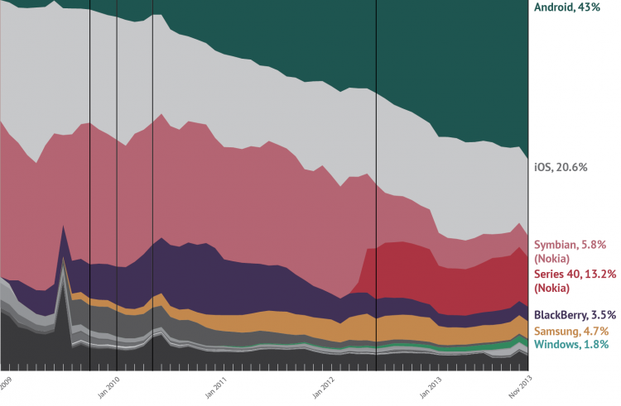
Mobile os timeline after android
1
2
3
4
5
Late 2009: Android-powered devices launched.
Jan 2010: Nexus One
May 2010: Android 2.2 (Froyo) with multi-tasking.
May 2012: Android surpasses Apple iOS
Nov 2013: Android doubles Apple iOS market share
Source: International Business Times
Notes:
(Continued): 2009- EOY 2013
5 key take-aways.
And Samsung + Windows creeping up
iOS, BB, Symbian down (while Nokia up a little recently)

Slide 13
World-Wide Smartphone sales (%)
Source: Gartner
Notes:
Every day more than 1 million new Android devices are activated worldwide.
For 2012 and 2013 (red)
http://www.gartner.com/newsroom/id/2665715

Slide 14
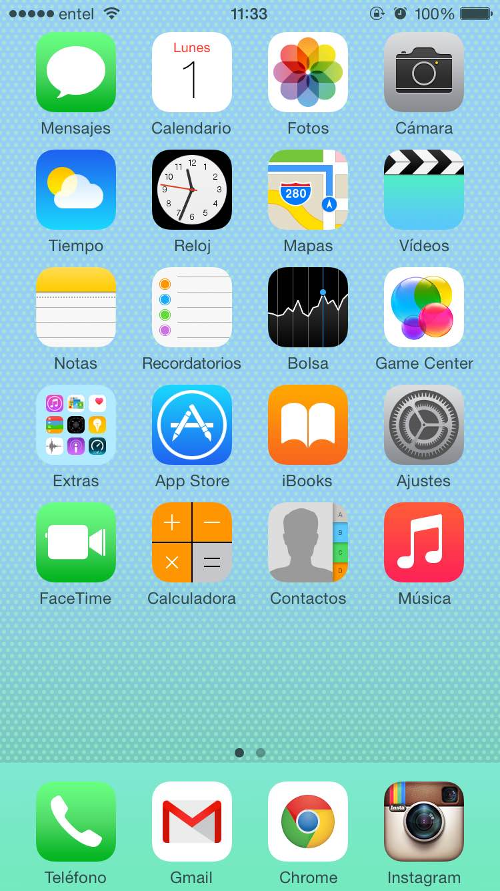
Apple - ios
Started the smartphone revolution in 2007 with the iPhone.
Closed source and proprietary and present only in Apple devices
Fully integration with Apple services and software: iCloud, Safari, App Store, Siri, iTunes, FaceTime, iMessage, Game Center etc..
Derived from Mac OS X:
XNU Kernel.
Mach-O file format.
iTunes for Sync, backup, updates.
Over-the-air updates (since iOS 5).
Multi-tasking (since iOS 4).
Notes:
XNU = X is not Unix. Apple acquired this OS Kernel for Mac OS X.
- No license for other manufacturers

Slide 15
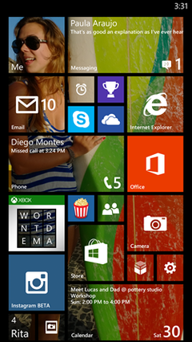
Microsoft – windows phone
Successor of Windows Mobile (no backward compatibility).
Closed source and proprietary.
Full integration with Microsoft services (IE, Office, Bing, Xbox).
Windows Phone 7 launched in October 2010
Windows Embedded CE architecture.
“Metro” User Interface.
Card-based task switcher (multitasking).
Windows Phone 8 released in October 2012
Windows NT Kernel = Compatibility with Windows 8.
Multi-core - NFC support, BitLocker encryption.
Removal storage support improved (Windows Phone App and MTP)
Over-the-air updates.
Windows Phone 8.1 released in April 2014
New Features: Cortana Voice Assistant, IE11, Notification center,

Slide 16
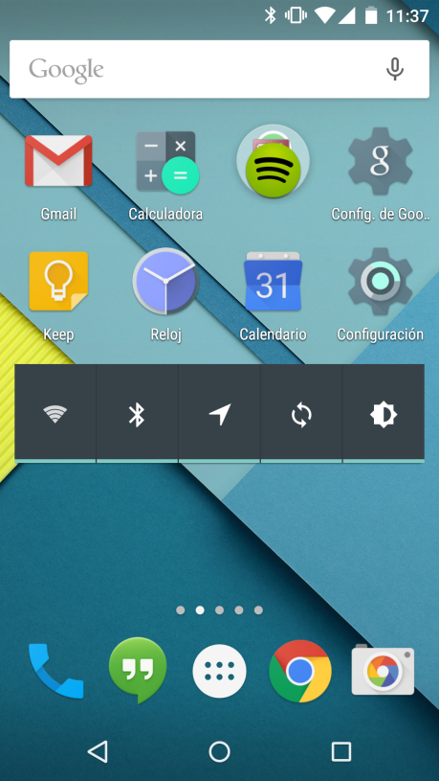
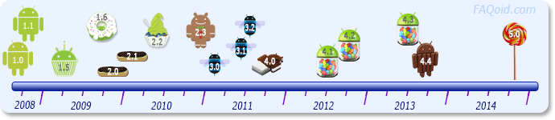
Google - Android
Developed by Android Inc in 2005. Acquired by Google in 2007.
Supported by the Open Handset Alliance
Free and open source (ok, not all).
Besides ARM, x86 and MIPS CPUs supported.
Over-the-air updates:
First delivered to Nexus devices directly from Google.
Carriers and manufacturers customize them for other devices (fragmentation problem).
Notes:
OHA – Multiple players in the mix.
Free and open source (except for proprietary components like Google/Carrier/Manufacturer apps)

Slide 17
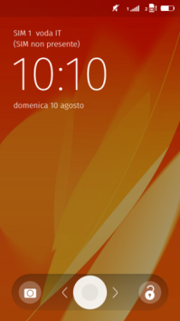
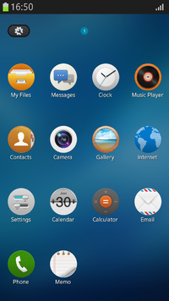
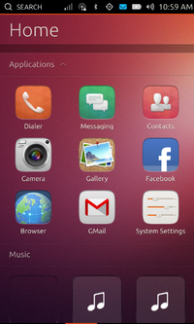
Others mobile os
Firefox OS
From Mozilla, Linux kernel OS, for smartphones, tables and computers
Community-based that use of open standards. It’s Open Source.
Gonk (Linux + HAL shared with Android Project) -> Gecko (firefox browser engine) -> Gaia + HTML5 Apps
Tizen
Hosted by Linux Fundation, guided by Intel, Samsung (“open-source”)
Inherit from MeeGo, LiMo
Designed for mobility and smart home appliances
Ubuntu Touch
From Canonical and Ubuntu community (Open-Source)
Supports smartphones, tables and smart-tv screens
Use software from Maemo, MeeGo, Maliit and Android
Ubuntu touch devices provides a full desktop experience when connected to an external monitor
Notes:
OHA – Multiple players in the mix.
Free and open source (except for proprietary components like Google/Carrier/Manufacturer apps)

Slide 18
Mobile os execution environments
Characteristic | Android | iOS | Windows Phone
Kernel | Linux | XNU (Mac OS X) | Windows NT (8)
Official Programming Language | Java | Objective-C/C/C++ | C# .NET or HTML5/JS
Executable File Format (ARM) | ELF | Mach-O | PE
Middleware | Dalvik Virtual Machine in Android<5 | Native | N/A | N/A
App File Format (ZIP) | .apk | .ipa | .xap in 7 (Silverlight) .appx in 8 (Windows)
App Compiled Code | dex (Dalvik Exec) | ELF | .app | .dll
Notes:
Execution environment:
Add licence
platform vs Characteristic

Slide 19
Mobile os security features
Characteristic | Android | iOS | Windows Phone
Approval Review | Automated (Bouncer) | Manual | Manual
Registration Cost | $25 | $99/year | $19
App Signing | Self-signed (or Verisign*) | Vendor-controlled | Vendor-controlled
Third-party installs | Configurable (disabled by default) | Not allowed | Not allowed
App Isolation | - User ID sandbox (setid) - Permissions by owner (r,w,x) ** | - Directory sandbox - Same privileges for each apps. | Chambers Model: Kernel/drivers System apps Standard apps
App Permissions | Static (manifest) | Dynamic (when it’s used) | Static (manifest)
Notes:
Security features: platform vs Characteristic
** = not if Rooted.
Windows Phone Security: https://www.msec.be/mobcom/ws2013/presentations/david_hernie.pdf
* Once in a lifetime signing ($500 as it's a bad business model for Certificate Authorities)

Slide 20
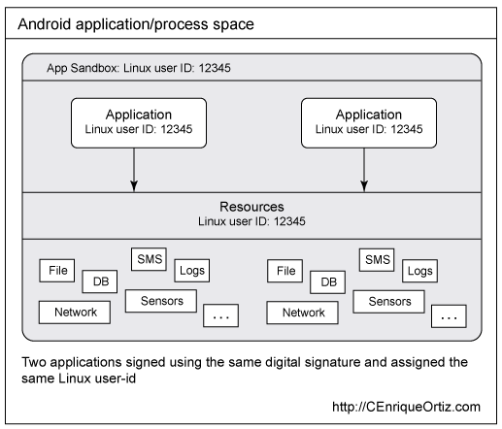
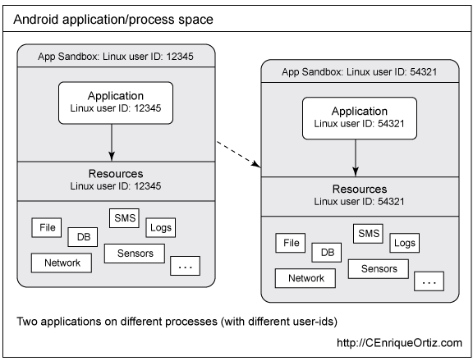
Running APPS in the same process vs Android sanboxing
Source: C. Enrique Ortiz - IBM
Notes:
sign both applications using the same private key
assign the same Linux user ID using the manifest file
(defining attribute android:sharedUserId)

Slide 21
System security bypass
Jailbreaking in iOS:
Purpose: Run software/code not authorized by Apple
Open security backdoors (e.g. SSH root password “alpine”).
Unlock carrier-locked iPhones.
Types: Tethered/Untethered.
Delivery:
Desktop-based: PwnageTool, redSn0w, greenpois0n, limera1n , evasi0n etc..
Drive-by: Jailbreakme series (exploits mobile browsers).
Rooting in Android:
Purpose: Get root privileges in the system.
Execute privileged operations (e.g. remove pre-installed applications)
Bypass restrictions from manufacturers and carriers (e.g. tethering)
Exploits in early days of Android malware:
RageAgainsTheCage (Android 2.2)
Gingerbreak (Android 2.3)
Notes:
JB:
- run un-auth’d software.
- sshd and root passwords.
- unlock carrier-locked phones.
- desktop or drive-by based.
Jailbreaking: Third-party software distributed by Cydia.
Rooting:
- get root priv.
- priv operations (app removal), bypass restrictions
- some early OS exploits to do it, used by malware.

Slide 22







Android security enhancements
Froyo 2.2 (May 2010)
Device Administrator
Gingerbread 2.3 (Feb 2011)
Hardware-based NX
Honeycomb 4.0 (July 2011)
Full-disk encryption
Ice Cream Sandwich (Dec 2011)
ASLR
Jelly Bean 4.2 (Nov 2012)
SMS notification
App Verification
ADB Auth
Certificate Pinning
Jelly Bean 4.3 (July 2013)
SE Linux (Permissive)
KitKat 4.4 (October 2013)
SE Linux (Enforced)
SSL CA Certificate Warning
Lollipop 5.0 (November 2014)
Encrypted by default
Smart Lock
Multi-user
Fix for OpenSSL man-in-the-middle
Kernel address leakage prevent
ELF Hardening
Vulnerabilities fixed
Source: Android Tamer
Notes:
Time-line: Android version vs security feature
Certificate Pining: If chain of certs doesn't match an error message is added.
SSL CA Certificate Warning: Warns when any certificate is added to the device certificate store
http://androidtamer.com/android-security-enhancements/

Slide 23
Mobile Malware Genesis
29A starting the MM revolution releasing the Cabir source code

Slide 24
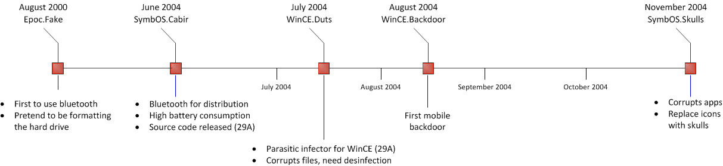
Genesis (2000-2004)
Source: Mobile Malware Attacks and Defense
Notes:
Timeline Genesis (2000): malware name vs features/contributions.

Slide 25
Skulls demo
Author: danooct1

Slide 26
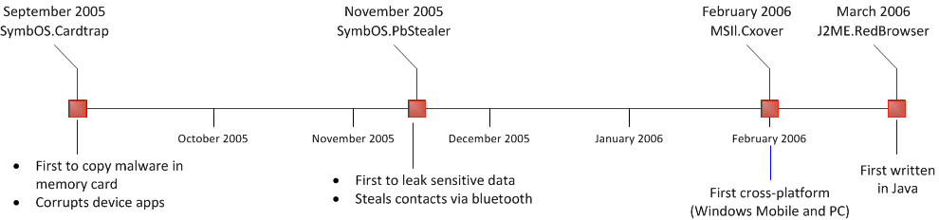
Middle ages (2005-2006)
Source: Mobile Malware Attacks and Defense
Notes:
Timeline Middle-ages (‘05-’06): malware name vs features/contributions.

Slide 27
RedBrowser demo
Author: UMULtd

Slide 28
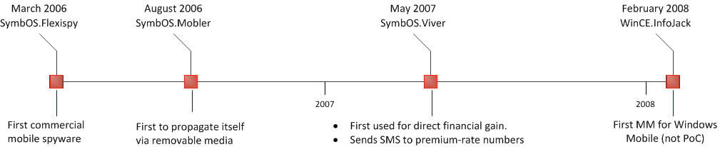
Middle ages (2006-2008)
Source: Mobile Malware Attacks and Defense
Notes:
Timeline Middle-ages (‘06-’08): malware name vs features/contributions.

Slide 29
Calm before the storm (2008 – 2010)
New platforms in the landscape with the smartphone revolution

Slide 30
Calm before the storm (2008-2010)
Smartphone revolution started:
Apple presented iPhone (iPhone OS 1.0) in 2007.
HTC Dream (Android 1.0) released in 2008.
Existing mobile operating system market share changed:
Symbian (Nokia) going down.
Windows Mobile (Microsoft) / Blackberry (RIM) going up.
Cross-platform mobile malware (J2ME - Mostly SMS Trojans)
New capabilities:
Disable operating system mechanism (e.g. app signature check)
Download other files from the Internet (downloader).
Call paid services (SymbOS Porndial and J2ME Smofree)
Polymorphism (WinCE PMCryptic - PoC)
Notes:
- smartphone revolution ‘07/’08
- (Previous slide reference) change in market share
- x-platform malware via runtimes.
- new capabilities (due to better tech and networks)

Slide 31
Symbian worm yxes: the first mobile botnet?
Detected in 2009 targeting Symbian OS 9 and above.
Spread via URL sent as SMS (novel distribution method).
Signed with a valid digital certificate (not seen before).
First to executes silent outgoing Internet communications (disabling UI dialogs).
HTTP communication:
Sent malware version and phone model
Responds OK or with another Symbian package (malware silently installed).
Exports contacts as vCards and sends the file, along with IMEI and IMSI, to a remote server.
Anti-Debugging features:
Kills system apps to avoid detection (ActiveFile app – File Explorer)
Encrypted URLs
Notes:
‘09 for Symbian 9+
URL in SMS
Valid cert
Hides UI dialogs to avoid being seen.
Sends contacts and phone info off device.
Downloads other packages.
Anti-Debug feautres (file explorer; Encrypted URLs)
Botnet? no commands implemented and/or sent by the remote server…
Detailed analysis: http://www.fortiguard.com/files/EICAR2010_Symbian-Yxes_Towards-Mobile-Botnets.pdf
Signed using a Express Signed account ($20) under a fake identity or using a hacked legitimate account.

Slide 32
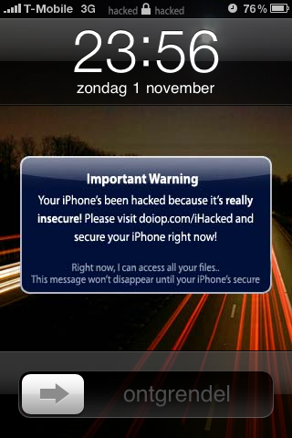
Ikee - First ios malware
Discovered in November 2009 in Netherlands
Jailbroken iPhones - $5 ransom to remove the malware
Used default SSH password “alpine” to remotely infect users.
2 days later, another variant appeared in Australia:
Same SSH vulnerability.
Self-propagating worm.
Changes wallpaper to Rick Astley picture (Rickrolling meme)
In November 18 a more malicious variant was discovered:
Named iKee.B (or duh)
Includes C&C logic (first truly mobile botnet)
Unique bot ID.
iPhone shell scripts (shell commands).
Includes code to leak SMS messages (feature disabled).
Source: ZDNet
Notes:
IKEE:
- 1st iOS in ‘09 in Dutch.
- JB phones for $5 ransom.
- default SSH password (port scanning)
OZ Variant
- 2 days later.
- WORM
- Wallpaper Rickrolling MEEM
Nov ‘ 18:
- C&C logic (1st true botnet)
- Unique Bot ID
- Shell scripts
- Leak SMS but disabled
Detalied analysis: http://mtc.sri.com/iPhone/
Apparently used to execute a pharming attach (change the hosts file to redirect an URL to another IP)

Slide 33
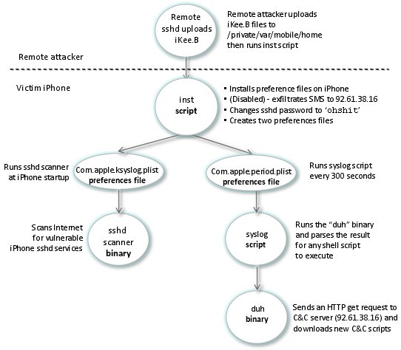
iKee.b (duh) structural overview
Source: SRI International
Notes:
Flow:
- SSH attack. Upload files (cat command)
- init: pass change, SMS (disabled)
- Left: worm.
- Right: C&C control.

Slide 34
first android malware in the wild
FakePlayer:
Found in the wild in August 2010.
Very simple and limited functionality.
Pretends to be a media player application.
SMS Trojan:
Sends SMS messages to premium-rate numbers.
Payload executed in the background without user’s consent.
Russian victims (limited impact).
Unknown distribution method (not in Android Market).
Tapsnake:
Found at almost same time as FakePlayer (August 16).
First Android malware found in Android Market (now Google Play).
Tracks GPS coordinates and sends to a remote server.
Service running in the background started after boot (novel feature)
Notes:
1st Android malware:
FakePlayer: Aug 2010 – SMS trojan
Simple and limted
Fakes a media app.
SMS to premium rate numbers.
Execute as service.
Russian only
Not found in Android Market (pre-GP)
Tapsnake: tracks location
Aug too!
Was in Android Market (GP)
Service after reboot (novel)
GPS co-ords and upload to remote server

Slide 35
Android malware revolution
Mobile botnets and repackaged apps in official and third-party app stores

Slide 36
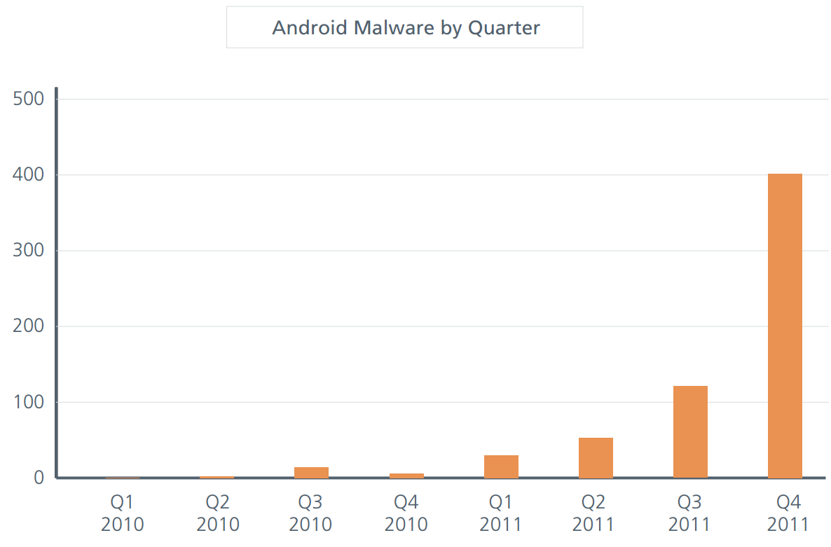
Android malware REVOLUTION
Source: McAfee Threats Report Fourth Quarter 2011
Notes:
Malware stats up to 2010-2011

Slide 37
Geinimi – first android botnet
Found December 2010 (after Christmas)
Distributed in third-party markets in China.
First “repackaged” Android malware.
Leaks sensitive information to a remote server:
Location coordinates (GPS).
Device identifiers (IMEI and IMSI).
List of installed applications.
Download additional APKs
Prompt the user to uninstall an application.
Executes commands sent by a remote C&C server.
Notes:
First Android BOTNET
First re-packaged (trojanised)
China app stores
Leaks sensitive data.
Download more APKs (not auto-installed)
Remote C&C
- Named Geinimi because it the name of the package that is injected was originally com.geinimi
- Detailed analysis: https://blog.lookout.com/_media/Geinimi_Trojan_Teardown.pdf

Slide 38
Genimi – sophisticated features
Communication using TCP sockets:
Malware designed to work with multiple instances in the same device.
If a newer variant is installed, the older variant no longer works.
Encryption (56-bit DES):
Communication with the C&C server.
Clear-text commands.
Strings in the binary.
Values in SharedPreferences (internal config file).
Early attempt to silently install an app (using pm install).
C&C Commands: dsms, smsrecord, call, showurl, install, updateHost, changeFrequency, applist, contactlist.
Notes:
Application updates supported!
Encryption
Auto-install attempts
C&C :
dsms (delete SMS)
smsrecord (leak send and received SMS messages)

Slide 39
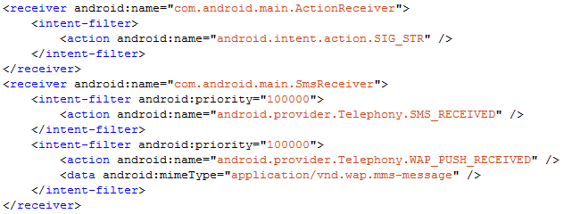
PJAPPS – Interception of SMS messages
Found February 2011 targeting Chinese users.
Similar to Geinimi:
Repackaged legitimate applications in third-party markets.
Mobile botnet.
One of the first malware families to intercept incoming SMS messages:
Notes:
PJAPPS:
- Targets Chinese victims.
- re-packages apps and botnet
- intercepts SMS
Detailed analysis: http://www.symantec.com/connect/blogs/android-threats-getting-steamy

Slide 40
DroidDream – The Android market Nightmare
Found by Reddit user “Lompolo” in March 2011.
21 repackaged apps uploaded to the Android Market by developer “Myournet”.
More than 50 applications found repackaged with DroidDream.
Simple XOR obfuscation (embedded key).
Attempts to root device using two public exploits:
“exploid” – vulnerability in udev event handling.
“rageagainsthecage” – vulnerability in adb.
If root, silently installs APK (hidden as sqlite.db) in system partition
Downloads more applications.
Novel contributions:
First malware found in the Android Market (50K to 200K installs in four days).
Introduced the use of publicly disclosed exploits to gain root privileges.
Notes:
DROIDDREAM:
- Android Market nightmare! Many apps!
- XOR
- Attempts ROOT w/ EXPLOITS
- If ROOT, install APKs (w/ odd filenames)
NOVEL
- many market installs.
- introduced exploits to get ROOT
Google Play and KASPERSKY – refunding customers!
https://blog.lookout.com/wp-content/uploads/2011/03/COMPLETE-DroidDream-Technical-Tear-Down_Lookout-Mobile-Security.pdf

Slide 41
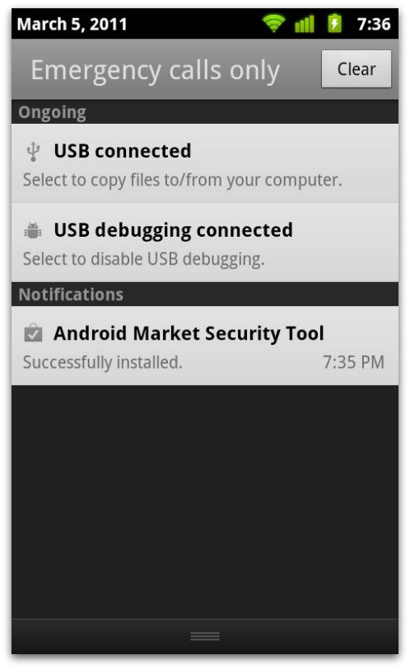
google reaction – remote kill switch
First public reaction from Google about an Android Security threat:
All malicious apps removed from the Android Market.
Malicious developer accounts suspended.
Remote removal of malicious apps from affected devices (kill switch)
Automatic download and install of “Android Market Security Tool” March 2011 to patch exploit without user’s intervention.
Malware authors took advantage of the fix (BgServ):
Android Market Security tool repackaged with malicious code.
Sends SMS messages instructed by a C&C server.
Intercepts incoming SMS messages from a specific number.
Targets Chinese telecom carriers (10086 and 10010).
Injected code based on a Google Code project.
Signed with a private key posted in a tutorial blog post.
Source: Sophos
Notes:
Google’s First reaction to Security threats on Android.
Remote Application Removal Feature seen for the first time in June 2010 (Jon Oberheide PoC):
https://jon.oberheide.org/files/summercon10-androidhax-jonoberheide.pdf
http://android-developers.blogspot.com/2010/06/exercising-our-remote-application.html
Private key in a tutorial blog post: http://www.londatiga.net/it/how-to-sign-apk-zip-files/

Slide 42
Android fundamentals
Android Architecture, App Components, Intents and Android Manifest

Slide 43
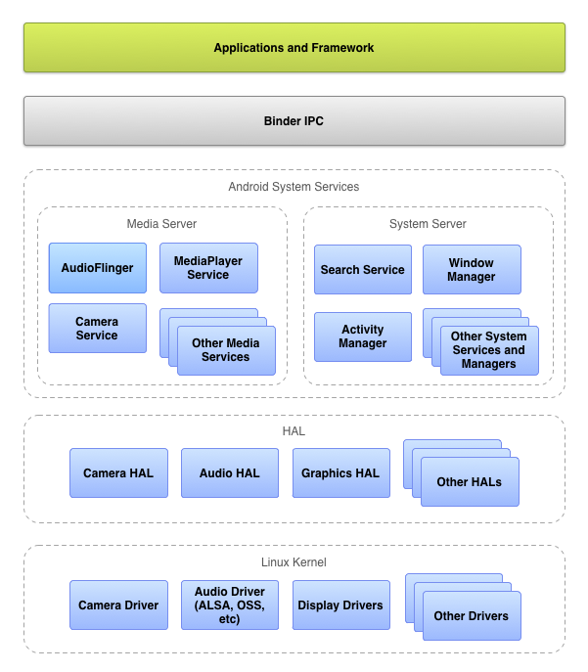
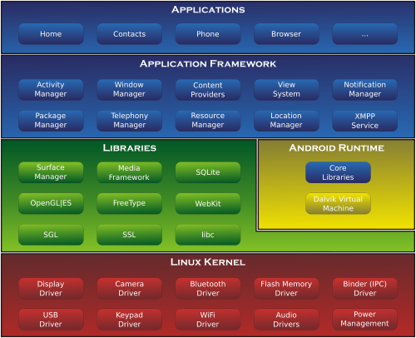
Android architecture
Notes:
Linux kernel 3.4 (since Ice Cream Sandwich) and 2.6.X (lower versions).
Libraries written in C
Dalvik Virtual Machine (register-based): Runs Dalvik dex-code which is translated from Java code.
Android 4.4 supports experimental rutime ART (not enabled by default)
Core libraries: API classes and methods.
Application Framework: Telephony Manager (IMEI, IMSI), Location Manager (GPS coordenates), Package Manager (Install/Unistall apps) etc..

Slide 44
Dalvik virtual machine (Android <5.0)
Designed for devices with constrained processing power, memory and storage.
Sandboxed environment for security, performance and reliability,
Written so devices can run multiple VMs efficiently.
Register-based Virtual Machine:
Better performance than stack-based VM (Java).
Less executed instructions than stack-based VM.
Executes files in the Dalvik Executable (.dex) format:
Java code is compiled into several .class files (Java bytecode).
.class files are transformed into the .dex format by the “dx”tool.
Dalvik Executable Format:
Constants (fields, methods, class, strings) of all classes mixed together.
Duplication of constants across .class files is eliminated in the .dex format.
Notes:
- Designed for Minimal Resources
- Sandbox (Linux users accounts)
- multiple VMs run in parallel.
- register-based (vs JAva’s stack based)
http://davidehringer.com/software/android/The_Dalvik_Virtual_Machine.pdf
The name of the village/town of the guy that created the first version of the VM

Slide 45
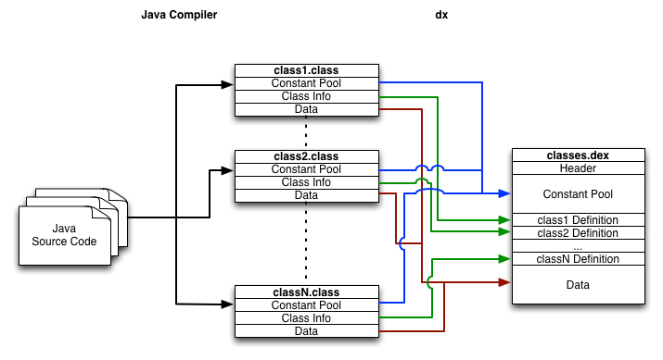
java vs dalvik bytecode
Source: Michael Spreitzenbarth Blog
Notes:
- .class converted to dex-format using “dx” tool.

Slide 46
Android runtime (android > 4.4)
Ahead-of-time (AOT) compilation
ART compiles apps using the on-device dex2oat tool.
DEX files converted to ELF files (native)
Improved garbage collection
Development and debugging improvements
Support for sampling profiler
Support for more debugging features
Improved diagnostic detail in exceptions and crash reports
Preview of ART is available in 4.4 and 5.0 replaced Dalvik with ART enterly
Notes:
- Designed for Minimal Resources
- Sandbox (Linux users accounts)
- multiple VMs run in parallel.
- register-based (vs JAva’s stack based)
http://davidehringer.com/software/android/The_Dalvik_Virtual_Machine.pdf
The name of the village/town of the guy that created the first version of the VM

Slide 47
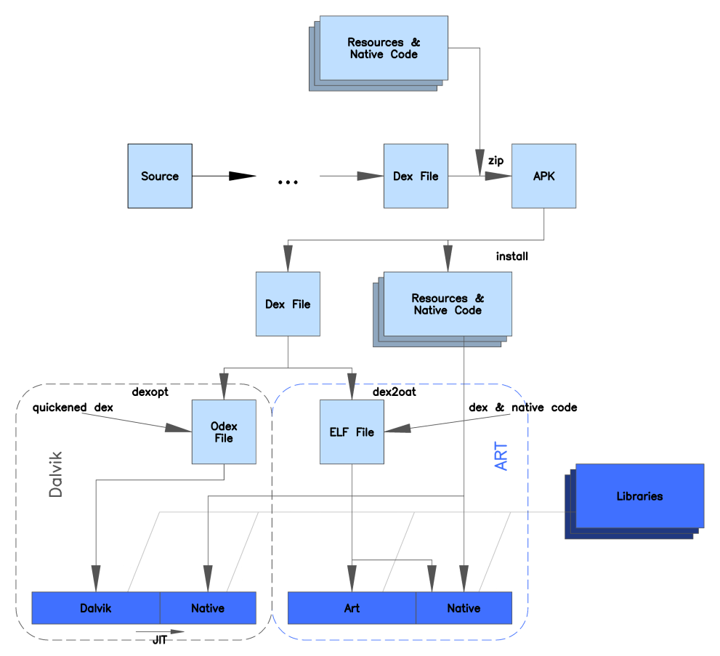
A comparation of Dalvik and art architectures
Author: MjolnirPants

Slide 48
Application sandboxing in Android vs linux
Source: C. Enrique Ortiz - IBM
Notes:
RECAP

Slide 49
Android application components
Activities (UIs): Single screen with an user interface.
Used to design user interfaces to including phishing attacks.
Services: Runs in the background without user interface.
Can be seen by the user if they are currently running (settings).
Legitimate use and used by malware and ad networks.
Broadcast Receivers: Responds to system-wide broadcast announcements
android.intent.action.BOOT_COMPLETED
android.provider.Telephony.SMS_RECEIVED
Content Providers: Manage shared app data.
Some system apps use to store sensitive information (e.g. contacts)
Component not commonly used by malware authors.
Notes:
Activities (UIs):
- phishing
Services:
- Runs in the background without user interface.
Broadcast Receivers:
- Responds to system-wide broadcast announcements
- e.g. BOOT_COMPLETED or SMS_RECEIVED
Content Providers:
- Manages shared set of app data. (sensitive e.g. contacts).

Slide 50
Android inter-process communication
Official (Android – Approved by Google)
Content Providers: Expose data to other processes (Photos, Videos, Databases)
Intents: Messages between Android apps.
Binder: Allows one Android process to call a routine in another Android process.
Non-Official (Unix-Type IPC Mechanisms)
Signals: A process can send signals to processes with the same UID and GID or in the same process group.
Pipes: Unidirectional byte-streams.
Sockets: Bidirectional byte-streams.
Message queues: Process can write a message to the queue that is readable for other processes.
Semaphores: Shared variable that can be read and written by many processes.
Shared Memory: Location in system memory that can be accessed by two or more processes.
Notes:
IPC: Dos and Don’t‘s.
http://www.nds.rub.de/media/attachments/files/2012/03/binder.pdf
Android IPC mechanisms allow you to limit who can call the IPC (exported = false)

Slide 51
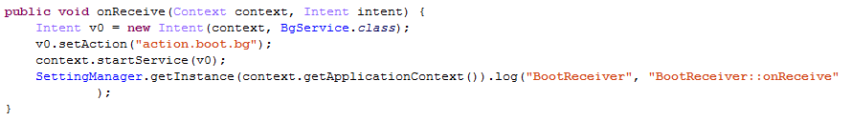
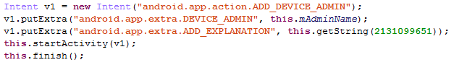
Intents – messages between components
Asynchronous messages between app components.
Can be used to start an activity, a service or deliver a broadcast.
Explicit (e.g. start a service):
Implicit (e.g. provide Device Administrator privileges):
Notes:
INTENTS: asynchronous messages between app components (e.g. UDP)
Explicit:
Specify the component to start by name (Start service)
Implicit:
Declare a general action to be done
Risk of broadcast theft (eavesdrops broadcasted intents) or service/activity hijacking (declare a component that receive implicit intents to access data and/or perform DoS)
Intent Forging: catch and re-send
Send malicious intents with injected data.

Slide 52
Sticky broadcasts
Characteristics:
Remain accessible after being processed.
Cannot be secured with a permission.
Not connected to an application so not removed upon app uninstallation.
Removed on phone restart (mostly not a suitable solution).
Can be modified or removed by apps with BROADCAST_STICKY permission.
Risks
May leak sensitive data.
Accessible to any receiver.
Malicious apps can remove it so intended app can’t receive it.

Slide 53
Android application permissions
Mechanism that enforces restrictions to processes
Android permissions are requested on installation (static)
Not when they are used (dynamic). E.g. iOS
Default Android apps have no permissions (permissions should be declared in Manifest).
146 permissions available in the latest Android (4.4 – API 19).
Custom permissions can be created for IPC.
Protection Levels:
Normal: Default value and low-level risk permission (no user’s approval required).
Dangerous: High-risk permission (requires confirmation before install).
Signature: Granted only if two apps’ certificates match (no explicit approval required).
SignatureOrSystem: Same as signature but granted to apps in the Android system image.
Notes:
Enforces restrictions to processes.
On-install (static) vs iOS’s dynamic (on-use) model.
http://developer.android.com/guide/topics/manifest/permission-element.html#plevel
Custom permissions can be used by any app except if they are “signature” because the other app should be signed with the same certificate
Permission Re-Delegation: https://www.usenix.org/legacy/event/sec11/tech/full_papers/Felt.pdf

Slide 54
Android Manifest
AndroidManifest.xml (encoded) inside the APK file.
Declare permissions needed by the app (not necessarily used)
android.permission.READ_PHONE_STATE
android.permission.RECEIVE_SMS
android.permission.SEND_SMS
android.permission.RECEIVE_BOOT_COMPLETED
android.permission.INSTALL_PACKAGES
Specify the minimum API level required by the app.
Declare app components (activities, services, receivers, content providers)
Declare Hardware/Software features required by the app (camera, Bluetooth, location, microphone etc..)

Slide 55
Questions?
alex_hinchliffe@mcafee.com
fernando_ruiz@mcafee.com

Slide 56
LAB 1: static analysis of android malware
Tools, methodology and tips to statically analyze an Android malware

Slide 57
VM for mobile malware analysis
Linux Virtual Machine
Development tools: Android SDK Manager
Android debug bridge (ADB)
Reverse Engineering:
AXMLPrinter2
Androguard
Dex2jar
JD-GUI
APK Tool
JadX

Slide 58
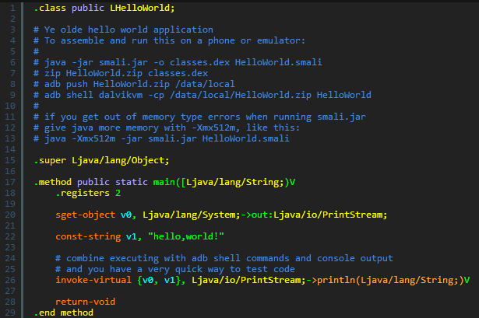
Smali/baksmali
Assembler (Smali)/disassembler (Baksmali) for the Dalvik Executable (.dex) format.
Based on Jasmin (assembler for the JVM) syntax but containing Dalvik opcodes:
Source: Android Cracking Blog
Notes:
http://androidcracking.blogspot.com/2011/02/more-smali-syntax-examples.html

Slide 59
Static Analysis of samples
Samples:
FakePlayer: http://contagiodump.blogspot.com/2010/08/trojan-sms-for-android-courtesy-of.html
TapSnake: http://contagiominidump.blogspot.com/2011/07/netmaxicomandroidsnake.html
Get the hash of the sample and check report in Virus Total.
Use APKTool to:
Decode resources and get smali code.
Analyze entry points and permissions in the XML.
Use dex2jar tool to convert .dex into a .jar.
Use JD-GUI to decompile the .jar.
Identify malicious behavior:
How many SMS messages are being sent?
To which numbers is the malware sending premium-rate numbers?
Which mechanisms are used to automatically execute the payload in the background?

Slide 60
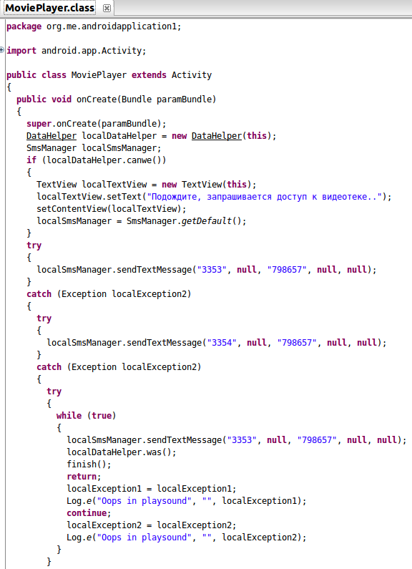
FakePlayer – SMS messages sent

Slide 61
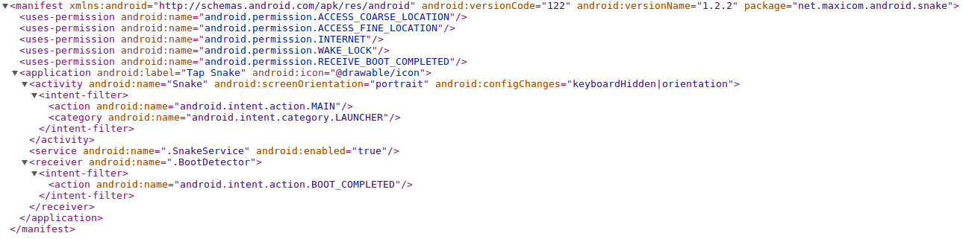
Tapsnake – entry points

Slide 62
LAB 2: Dynamic analysis of android malware
Use SDK emulator to analyze Android malware

Slide 63
Dynamic analysis of walktxt
Open Android SDK Manager (Knife -> Development Tools -> Android SDK Manager)
Click on Tools -> Manage ADVs -> New and create a new ADV:
ADV Name: 23
Device: Nexus S
Target: Android 2.3.3
In the Terminal go to /usr/share/adt-bundle/sdk/tools and execute :
“emulator @23 -tcpdump /home/santoku/Desktop/capture.pcap”
Create a new contact with the phone number 15555215556.
Install the provided APK in the emulator using the command adb install <sample.apk>
Go back to the ADV Manager, select the ADV and click on Start -> Launch
Execute the malware and see what happens.
Open capture.pcap with Wireshark and analyze the network traffic.
Notes:
Alternative method to open SDK manager: In terminal type android

Slide 64
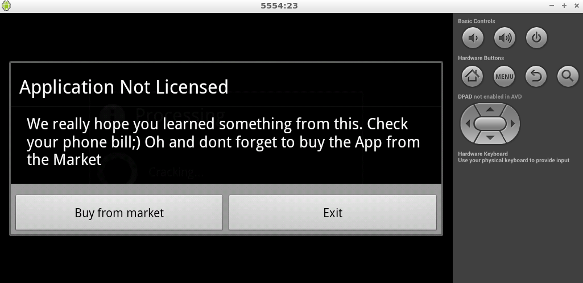
Walktxt – infected device

Slide 65
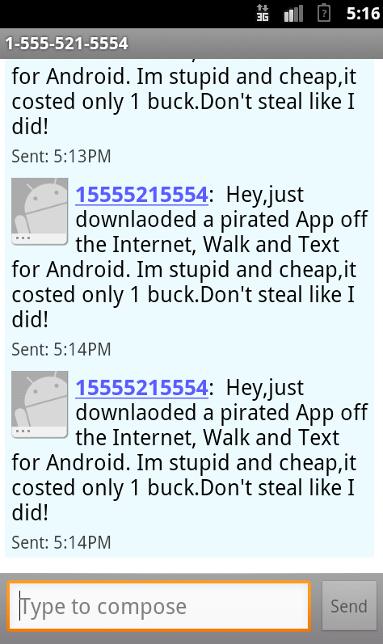
Walktxt – sms spam

Slide 66
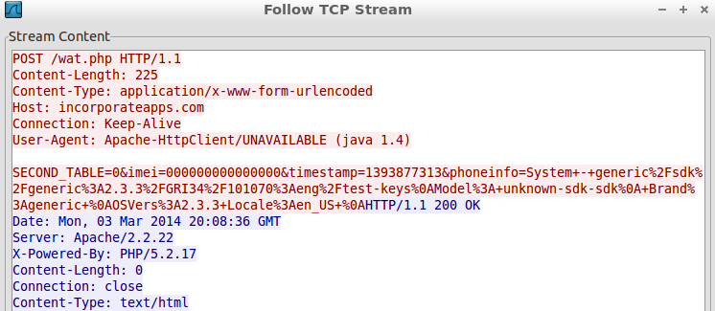
WALKtxt – device info leaked

Slide 67
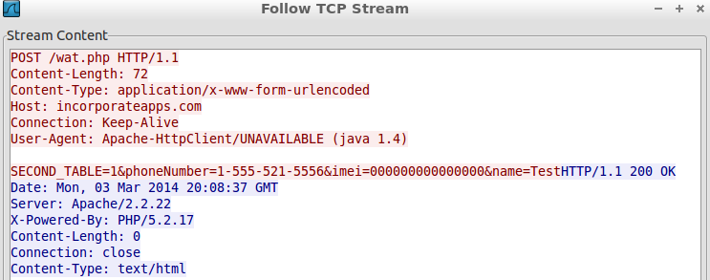
Walktxt – sms sent reported to the server

Slide 68

End

Slide 69
Analog systems (1g)
First 1G networks:
Japan by NTT (1979)
Nordic countries by NMT (1981)
AMPS used FDMA to allocate one or several frequency bands or channels.
Disadvantages: 10,000 calls = 10,000 channels.
Security Issues:
Analog = Just voice (Non-encrypted)
“Jamming”
“Cell phone cloning”:
Intercept handset ESN (Electronic Serial Number).
Intercept MNT (Mobile Directory Number) or CDT (Cellular Telephone Number).
Use them in another device to make free calls.
Notes:
NMT - Nordic Mobile Telephone
NTT - Nippon Telegraph and Telephone
ESN for billing purposes
FDMA - Frequency Division Multiple Access

Slide 70
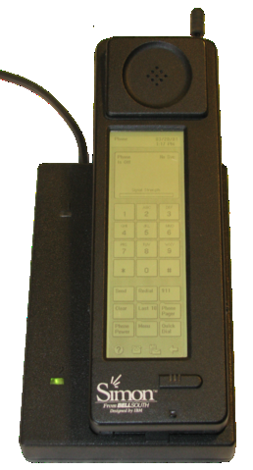
Digital Cellular networks (2g)
Analog -> Digital
Europe (GSM) vs U.S (Digital AMPS):
TDMA: Divide the signal into different time slots.
CDMA: Encode with a pseudo-random digital sequence scheme.
New technologies:
SMS (Short Message Service) or text messages.
IBM Simon: The world’s first smartphone in 1993
Security:
Less susceptible to jamming (DoS).
Phone calls encrypted:
A5/1 and A5/2 in GSM systems (weak)
CAVE in CDMA Systems
Notes:
TDMA - Time Division Multiple Access
CDMA - Code-Division Multiple Access
CAVE - Cellular Authentication and Voice Encryption
IBM Simon: Calendar, address book, clock, calculator, notepad, e-mail, touchscreen with QWERTY keyboard.
GSM = Group Spécial Mobile
A5/1 and 2 general design leaked in 1994 and entirely reverse engineered in 1999
CAVE in CDMA: http://www.ee.iitb.ac.in/eesa/Techno-Journalism/prize-winning%20entries/2nd_prize_CDMA_technology_Amit_Balani.pdf

Slide 71
Mobile broadband data (2.5G, 2.7G and 3G)
2.5G and 2.7G (2G + Data):
GPRS: 50 kbit/s max (40 kbit/s in practice)
CDMA2000-1X: up to 307 kbit/s
EDGE: 250 kbit/s (150 kbit/s in practice)
Internet and data in the phone: WAP, MMS and E-mail.
First commercial 3G network by NTT DoCoMo Japan in October 2001.
Circuit switching -> Packet switching.
3G Standards: WCDMA (Europe/Japan), CDMA2000 (U.S) and TD-SCDMA (China).
Security:
Data and voice encrypted using A5/3 (stronger and not practically vulnerable)
New security hardware (GSM): Subscriber Identity Module (SIM Card)
IMSI (International Mobile Subscriber Identity).
Encryption key to identify and authenticate subscribers.
Notes:
GPRS - General Packet Radio Service
EDGE - Enhanced Data Rates
WAP - Wireless Application Protocol
MMS - Multimedia Messaging Service
GSM Security and Encryption: http://www.hackcanada.com/blackcrawl/cell/gsm/gsm-secur/gsm-secur.html
http://www.hackcanada.com/blackcrawl/cell/gsm/gsm-secur/gsm-secur.html

Slide 72
IP Networks: 3.5G and 4G
Circuit switching (for voice) -> VoIP
3.5G (WCDMA):
HSPA: Up to 14 Mbit/s (download) and 5.76 Mbit/s (upload).
Evolved HSPA: Up to 84 Mbit/s (download) and 10.8 Mbit/s (upload).
4G:
WiMAX (IEEE 802.16)
LTE (GSM)
5G:
No standardization yet.
Estimated to be delivered beyond 2020.
Notes:
HSPA: High-Speed Packet Access
LTE: Long Term Evolution

Slide 73
Genesis (2000-2004)
Threat | Date | Payload | Novel Contribution
Epoc.Fake | August 2000 | Pretend to be formatting a hard drive. | First to use Bluetooth for distribution.
SymbOS.Cabir | June 2004 | High battery consumption. | Source code released by malcode group 29A.
WinCE.Duts | July 2004 | Corrupts files and need disinfection. | Parasitic infector PoC for Windows Mobile by 29A.
WinCE.Backdoor | August 2004 | Full remote access to the device. | First to install a backdoor on a mobile device.
SymbOS.Skulls | November 2004 | Corrupts apps and replace icons with Skulls. | Overwrite files without user permission (destructive payload).
Source: Mobile Malware Attacks and Defense
Notes:
Epoc.Fake spotted in Japan
Cabir, considered the first mobile malware. Believed to be created in France, the author goes by the name “Vallez”. Started Mobile Malware revolution.
Duts: Infects .EXE files but as PoC because it need approval from the user to start infecting files.
Backdoor: Creates a file in the startup and sends IP to upload/download files in a PDA.
Skulls: Exploits a vulnerability in Symbian. The author goes by the name Tee-222

Slide 74
Middle ages (2005-2008)
Threat | Date | Payload | Novel Contribution
SymbOS.Cardtrap | September 2005 | Corrupts device apps and copy Windows malware in memory card. | First to attempt infecting another operative system (Windows)
SymbOS.PbStealer | November 2005 | Steals device phone contacts and sends it via Bluetooth. | First to access sensitive information to send it to another device.
J2ME.RedBrowser | March 2006 | Sends continuous SMS messages to the same phone number. | First written in Java.
MSIL.Cxover | March 2006 | Delete all files from “My Documents”. | First cross-platform (Windows Mobile and PC).
Source: Mobile Malware Attacks and Defense
Notes:
Cardtrap: Windows payload is a variant of Korgo bot
RedBrowser: Attempt to create a possible financial loss
MSIL.Cxover: PoC and first MM to infect “silently”

Slide 75
Middle ages (2005-2008)
Threat | Date | Payload | Novel Contribution
SymbOS.Flexispy | March 2006 | Leaks phone calls information and SMS messages. | First publicly marketed spy app for mobile devices.
SymbOS.Mobler | August 2006 | Disable system functions like task manager, folder options etc… | First to propagate by copying itself to any writable media on the device.
SymbOS.Viver | May 2007 | Sends SMS messages to premium-rate numbers | First used for direct financial gain.
WinCE.InfoJack | February 2008 | Collected sensitive information and sends it to a remote server. | First (not PoC) targeting Windows Mobile.
Source: Mobile Malware Attacks and Defense
Notes:
Cardtrap: Windows payload is a variant of Korgo bot
RedBrowser: Attempt to create a possible financial loss
MSIL.Cxover: PoC and first MM to infect “silently”

Slide 76


Android security enhancements
Android 1.5 (cupcake)
Android 2.2 (Froyo)
Stack / buffer overrun protection | ProPolice to prevent stack buffer overruns (-fstack-protector)
Integer overflow protection | safe_iop
Integer overflow memory allocation | OpenBSD calloc
chunk consolidation attack | Extensions to OpenBSD dlmalloc() to prevent double free()
Device Administration | Android Device Administration API added

Slide 77


Android security enhancements
Android 2.3 (Gingerbread)
Android 3.0 (Honeycomb)
format string vulnerability protection | added -Wformat-security -Werror=format-security
code execution prevention on stack and heap | Hardware-based No eXecute (NX)
null pointer dereference protection | mmap_min_addr
full filesystem encryption | Full disk encryption added

Slide 78


Android security enhancements
Android 4.0 (Ice-Cream Sandwich)
Android 4.1 (Jelly Bean)
ASLR support | ASLR support started appearing although not fully. Multiple flaws were present dynamic linker didn't had ASLR and many more outlined in reference link
PIE (Position Independent Executable) support | Support for binaries compiled with GCC's -pie -fPIE flags (executables to be position independent)
Read-only relocations / immediate binding | (-Wl,-z,relro -Wl,-z,now)
kernel address leakage prevention | dmesg_restrict and kptr_restrict enabled
ELF Hardening | RELRO / BIND_NOW flag default. This hardens those binaries against attacks that may attempt to overwrite the GOT and other sensitive ELF structures by making them read-only at startup.
ASLR support | Full ASLR support

Slide 79
Android security enhancements
Android 4.2 – 4.3 (Jelly Bean)
4.3 | Restrict Setuid from Android Apps | No Zygote spanned process is allowed to execute setuid program. /system is mounted with nosetuid
4.3 | SE_Linux => Permissive | allows logging but doesn't restrict actions
4.2.2 | ADB Authentication | Prevents unauthorised use of ADB by the use of RSA keypair for authentication
4.2 | Application verification | user can opt for client side bouncer instance and google can verify malacious applications before installation.
4.2 | Certificate Pinning | if chain of certs doesn't match an error message is added.
4.2 | installd config | installd runs as non root from start.
4.2 | ContentProvider security | by default contentprovider will be set to false for API <=17
4.2 | premium SMS notification | SMS to premium numbers now display a notification and only allow needing when explicitely accepted.
4.2 | SecureRandom implementation | SecureRandom implementation based on OpenSSL, Bounty castle implementation removed.
4.2 | JavascriptInterface annotation | JavascriptInterface needs to be annotated for webview

Slide 80

Android security enhancements
Android 4.4 – 4.4.4 (KitKat)
4.4.4 | Block access to java.lang.Object.getClass in injected Java objects | Throws a java.lang.SecurityException on Browser UI thread when an attempt is made to execute java.lang.Object.getClass from JavaScript code via an injected Java object.
4.4.4 | Fix for OpenSSL man-in-the-middle | CVE ID : CVE-2014-0224
4.4.2 | Removal of the "App Ops" application permissions control system | App Ops permission system which was available since 4.3 was removed completely from GUI in this release
4.4 | dm-verity | transparent integrity checking of block devices. dm-verity helps prevent persistent rootkits that can hold onto root privileges and compromise devices.
4.4 | SE_Linux => Enforced Mode | all root domain binaries are working in enforced mode. remaining still work in permissive mode
4.4 | FORTIFY_SOURCE | Level 2 : full source code compiled with FORTIFY_SOURCE and clang support added.
4.4 | SSL CA Certificate Warnings | Warns when any certificate is added to the device certificate store

Slide 81

Android security enhancements
Android 5.0 (Lollipop)
Encrypted by default | On devices that ship with L out-of-the-box, full disk encryption is enabled by default to improve protection of data on lost or stolen devices.
Android sandbox reinforced with SELinux. | Android now requires SELinux in enforcing mode for all domains.
Smart Lock | Allow devices to be unlocked automatically when close to another trusted device (via NFC, Bluetooth) or being used by someone with a trusted face.
Updated cryptography for HTTPS and TLS/SSL | TLSv1.2 and TLSv1.1 is now enabled, Forward Secrecy is now preferred, AES-GCM is now enabled, and weak cipher suites (MD5, 3DES, and export cipher suites) are now disabled
Security Fixes | CVE-2014-3153 Towelroot CVE-2014-1939 Inject Java code via webkit java.io.ObjectInputStream fail to check a serialized object
Multi-user | droid now provides for multiple users on phones and includes a guest mode that can be used to provide easy temporary access to your device without granting access to your data and apps.

